Slide 1


Anomaly Detection
Notes:
Everyone loves a mystery, and at the heart of it, that’s what anomaly detection is—spotting the unusual, catching the fraud, discovering the strange activity. Anomaly detection has a wide range of useful applications, from banking security to natural sciences to medicine to marketing, image processing
Anomaly detection carried out by a machine-learning program is actually a form of artificial intelligence.

Slide 2

Agenda
Anomaly
Introduction
Shape of Anomaly Detection
T-Digest for threshold Automation
Anomalies in Sporadic Events
02
Notes:
We are going to give a brief introduction to Anomaly and types of anomalies and there usage in different domains..
Then we will head to understanding what is “normal” and how probabilistic models can be used along with expert for deriving equations to find anomalies
A popular method know as t-digest to find point anomalies
Also anomaly detection in continuous events.

Slide 3

What is Anomaly
Anomaly is a pattern in the data that does not conform to expected behaviour
Anomalous events occur relatively infrequently
03
Notes:
Anomaly detection is about finding what you don’t know to look for
You are searching for anomalies, but you don’t know what their characteristics will be. If you did, you could use a different form of machine learning, called classification, or you would just write specific rules to find the anomalies. But that’s not generally where you start
Most important aspect of anomaly detection: Finding what is normal
Then one can spot data that falls outside of what is normal
Anomalies are defined not by their own characteristics, but in contrast to what is normal.
looking for events that are rare relative to what is expected and that often are surprising, or at least undefined ahead of time.
s

Slide 4



Applications of Anomaly Detection
Intrusion Detection:
- Process of monitoring the events occurring in a computer system or network and analyzing them for intrusions
- Intrusions are defined as attempts to bypass the security mechanisms of a computer or network ‏
Fraud Detection:
Detection of criminal activities occurring in commercial
Organizations.
04
Notes:
An intrusion detection system (IDS) monitors network traffic and monitors for suspicious activity and alerts the system or network administrator. In some cases, the IDS may also respond to anomalous or malicious traffic by taking action such as blocking the user or source IP address from accessing the network.
An IDS which is anomaly based will monitor network traffic and compare it against an established baseline. The baseline will identify what is “normal” for that network- what sort of bandwidth is generally used, what protocols are used, what ports and devices generally connect to each other- and alert the administrator or user when traffic is detected which is anomalous, or significantly different than the baseline.
For more information click- https://www.lifewire.com/introduction-to-intrusion-detection-systems-ids-2486799
https://en.wikipedia.org/wiki/Intrusion_detection_system
Data mining and statistics help to anticipate and quickly detect fraud and take immediate action to minimize costs. Through the use of sophisticated data mining tools, millions of transactions can be searched to spot patterns and detect fraudulent transactions.
An important early step in fraud detection is to identify factors that can lead to fraud. What specific phenomena typically occur before, during, or after a fraudulent incident? What other characteristics are generally seen with fraud? When these phenomena and characteristics are pinpointed, predicting and detecting fraud becomes a much more manageable task.

Slide 5


Applications of Anomaly Detection
Healthcare Informatics:
Detect anomalous patient records
Indicate disease outbreaks, instrumentation errors, etc.
Image Processing:
Detecting outliers in image monitored over time
Detecting anomalous regions within an image
05

Slide 6
Types of Anomaly : Point Anomaly
Y
A single instance of data is anomalous if it's too far off from the rest.
Detecting credit card fraud based on amount spent
N₁
o₁
O₃
o₂
N₂
X
06

Slide 7
Types of Anomaly : Contextual Anomaly
If a data instance is anomalous in a specific context.
If transaction occurs at certain time or certain region. e.g. large spike at middle of night
07
Notes:
Contextual anomalies: The abnormality is context specific. This type of anomaly is common in time-series data.
Business use case: Spending $100 on food every day during the holiday season is normal,

Slide 8
Types of Anomaly : Collective Anomaly
Collection of related data instances is anomalous with respect to the entire data set, but not individual values
Anomalous Subsequence
08
Notes:
Collective anomalies: A set of data instances collectively helps in detecting anomalies.
Business use case: Someone is trying to copy data form a remote machine to a local host unexpectedly, an anomaly that would be flagged as a potential cyber attack

Slide 9
Taxonomy
Anomaly Detection
Point Anomaly Detection
Classification Based
Nearest Neighbour Based
Clustering Based
Statistical
Others
Neural Networks Based
SVM Based
Density Based
Distance Based
Parametric
Non-parametric
Information Theory Based
T-Threshold
Contextual Anomaly Detection
Collective Anomaly Detection
Windows and Clusters
08
Notes:
There are different techniques to find anomalies of different types
The methods are employed based on the domain problem
In this class we will focus mainly on the concept of anomaly and its detection using t-Threshold, windows & clusters.

Slide 10
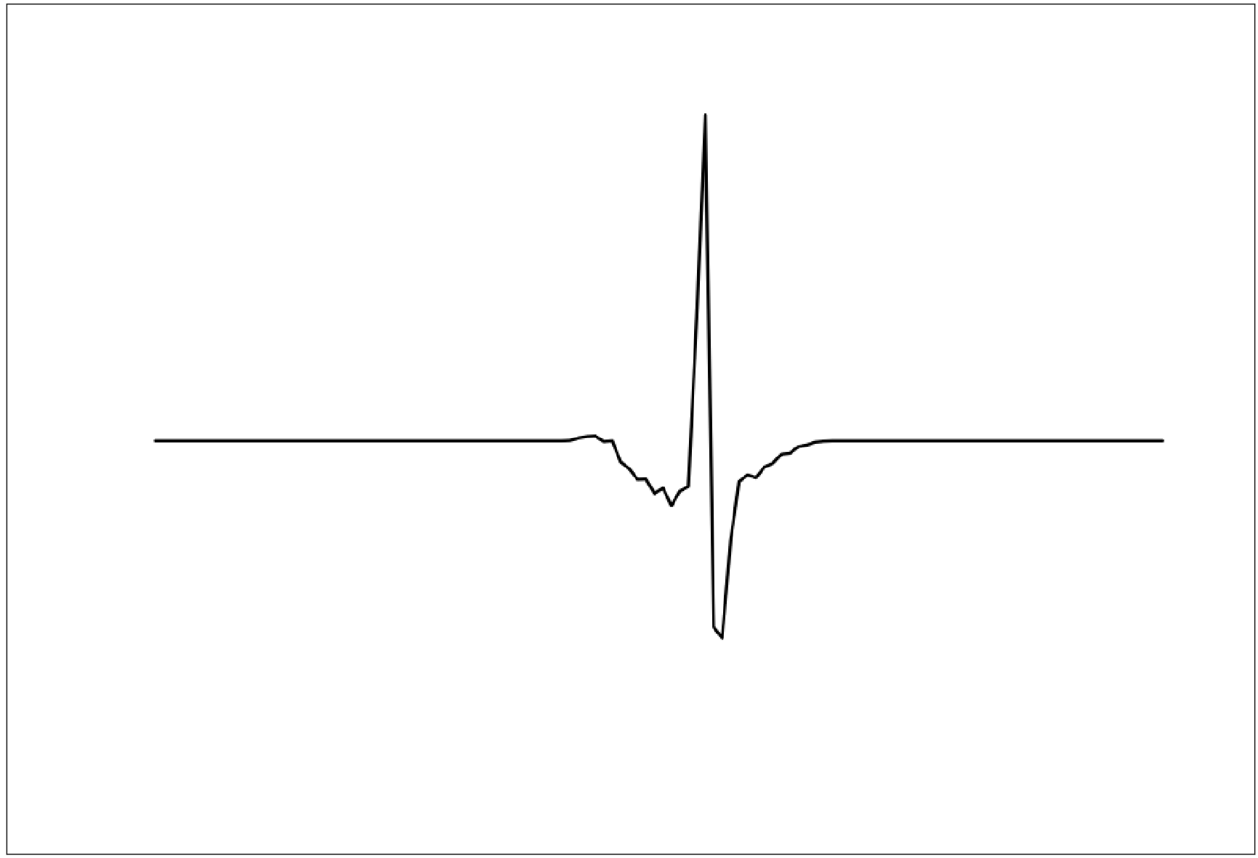
Spot an Outlier
09
Notes:
Ask students to find anomaly in this picture
The exciting thing about anomaly detection is the sense of discovery. You need a program that can spot what is unusual, so anomaly detection models are on the lookout for the outliers.

Slide 11
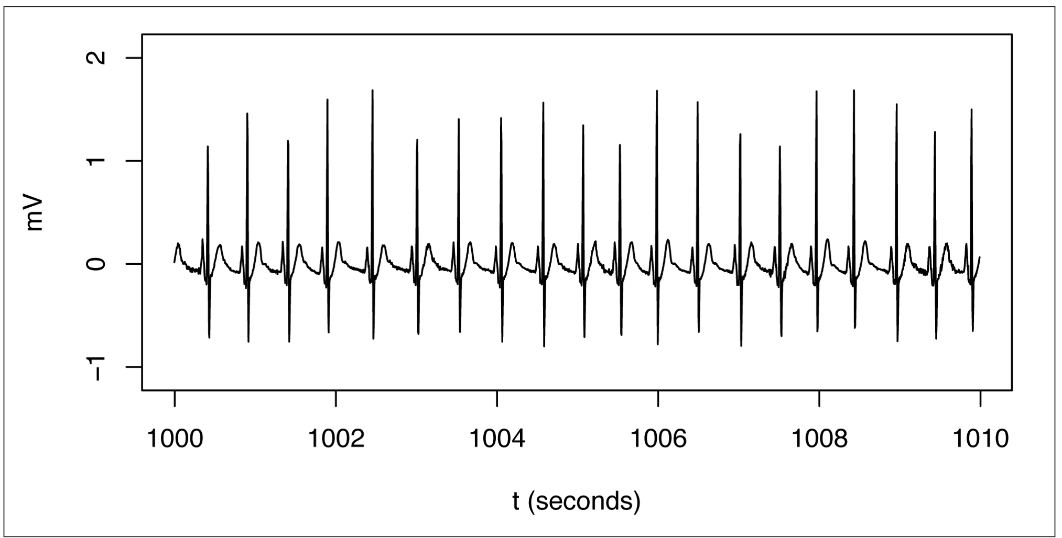
Figure out what “normal” is
10
Notes:
The spike that is thought to be anomaly is “normal” in this picture
Discovering “ normal” is a little more complicated than it sounds, especially in a complex system. Often, to do this, you need a machine learning model. To do this accurately, you also need a large enough sampling of data to get an accurate representation. Then you must find a way to analyze the data and mathematically define what forms a regular pattern in your training data.

Slide 12
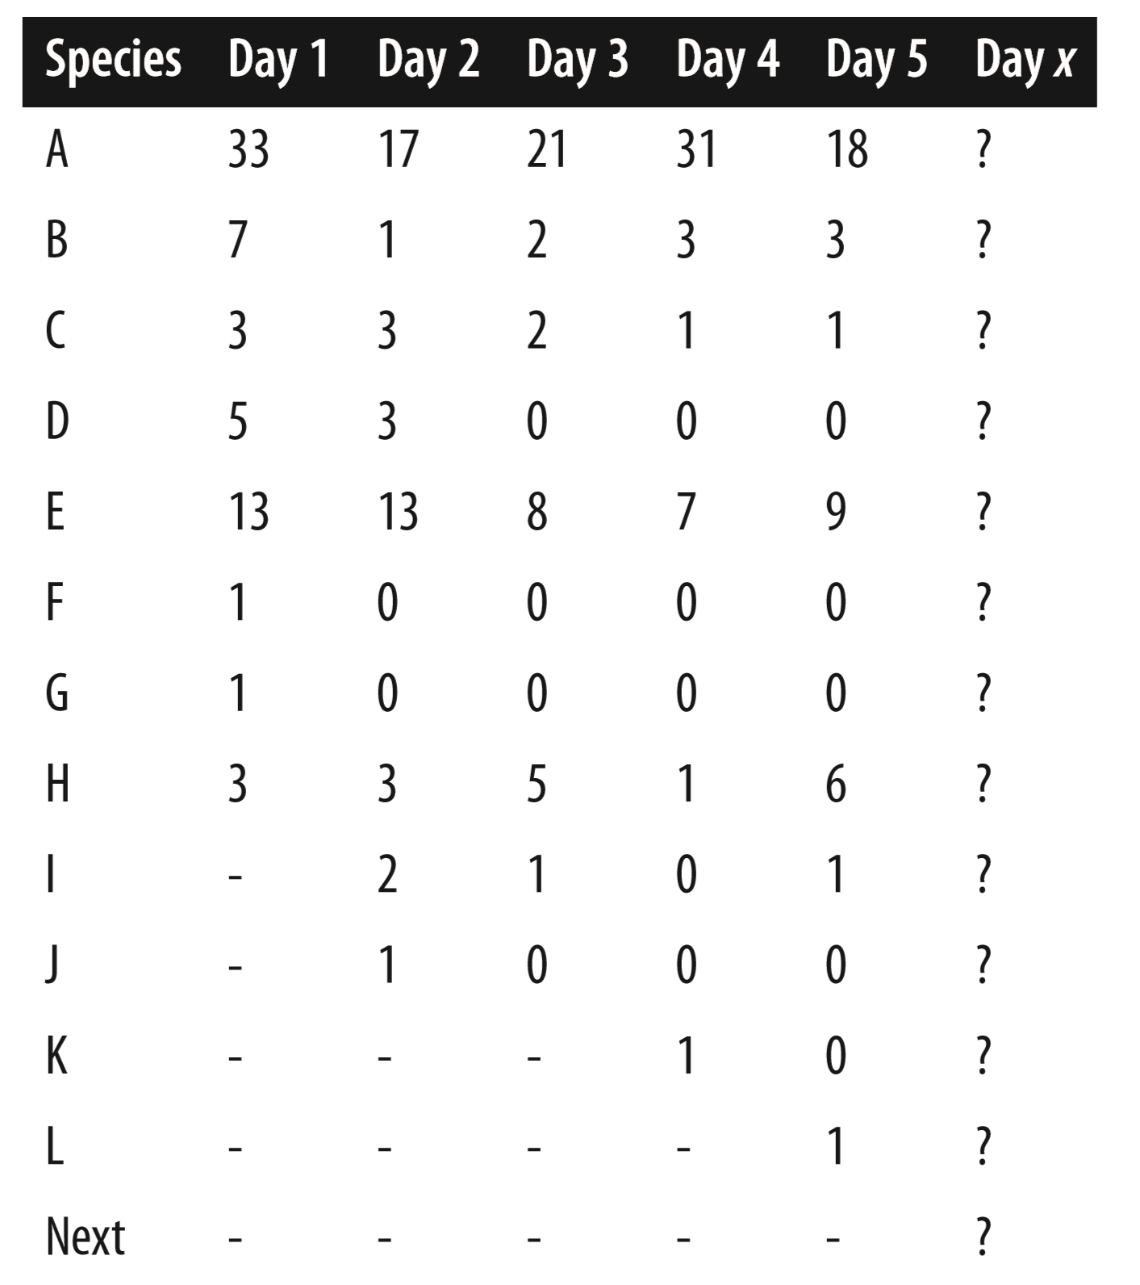

Finding “Normal”
Probabilistic way of approach
Likelihood of occurring of an instance can be predicted
11
Notes:
Suppose you are studying birds in a particular location, and you observe, identify and count how many birds and of what species pass by a particular observation point over the course of days.
Bird watching provides a simple thought experiment to show how a probabilistic model works.
The synthetic data of this simplified example helps you think about how, based on the observations you’ve made, you could build a model to predict several things like
what you expect to observe on Day x.
This prediction is nicely captured in the form of a probabilistic model.
It assumes that all things (species) have at least some likelihood to occur, that some are more likely than others, and some are extremely rare (or not yet observed), and so the estimate of their likelihood will be a very small value.
You can even predict how many new species you might expect on a given day, even if you cannot predict which species they will be.
You can assign a probability for each event or type of event and thus describe in probabilistic terms what you estimate to be “normal.”

Slide 13

Human Insight Helps
Human insight from someone with domain knowledge is a valuable resource to put a probabilistic model into the proper context
12
Notes:
Our bird-watching thought experiment can also illustrate this point. Suppose you observe a brown pelican—is this to be expected?
A domain expert would tell you yes, if you live near a coastal region of North America, or no if you live for instance in the inland state of North Dakota.
The point is that human insight from someone with domain knowledge is a valuable resource to put a probabilistic model into the proper context.
Continuing with our bird-watching thoughts, human experience might also inform you that some sequential events tend to be related. If you see one pelican fly by, it’s reasonable to expect several more almost immediately because they often fly in a sort of squadron.
But you would not expect a couple of hundred pelicans in rapid succession. This knowledge suggests that sequential measurements may not be entirely independent

Slide 14

Interaction
First step in anomaly detection is using your model to discover what is normal also requires human insight to structure the model mathematically.
13
Notes:
In building a machine-learning model for anomaly detection, you have to identify the best choice of data, figure out how to put it into a form acceptable to your algorithm and then acquire enough data for training your model.
In other words you will use data initially to let the model discover patterns that you will then need to interpret in order to determine the baseline or normal situation.
This may require a number of adjustments to the algorithm you use before you end up with something that makes sense.
The more you know about the situation being investigated, the more easily and accurately you can decide when your model has achieved the first goal of anomaly detection by finding what is normal.

Slide 15
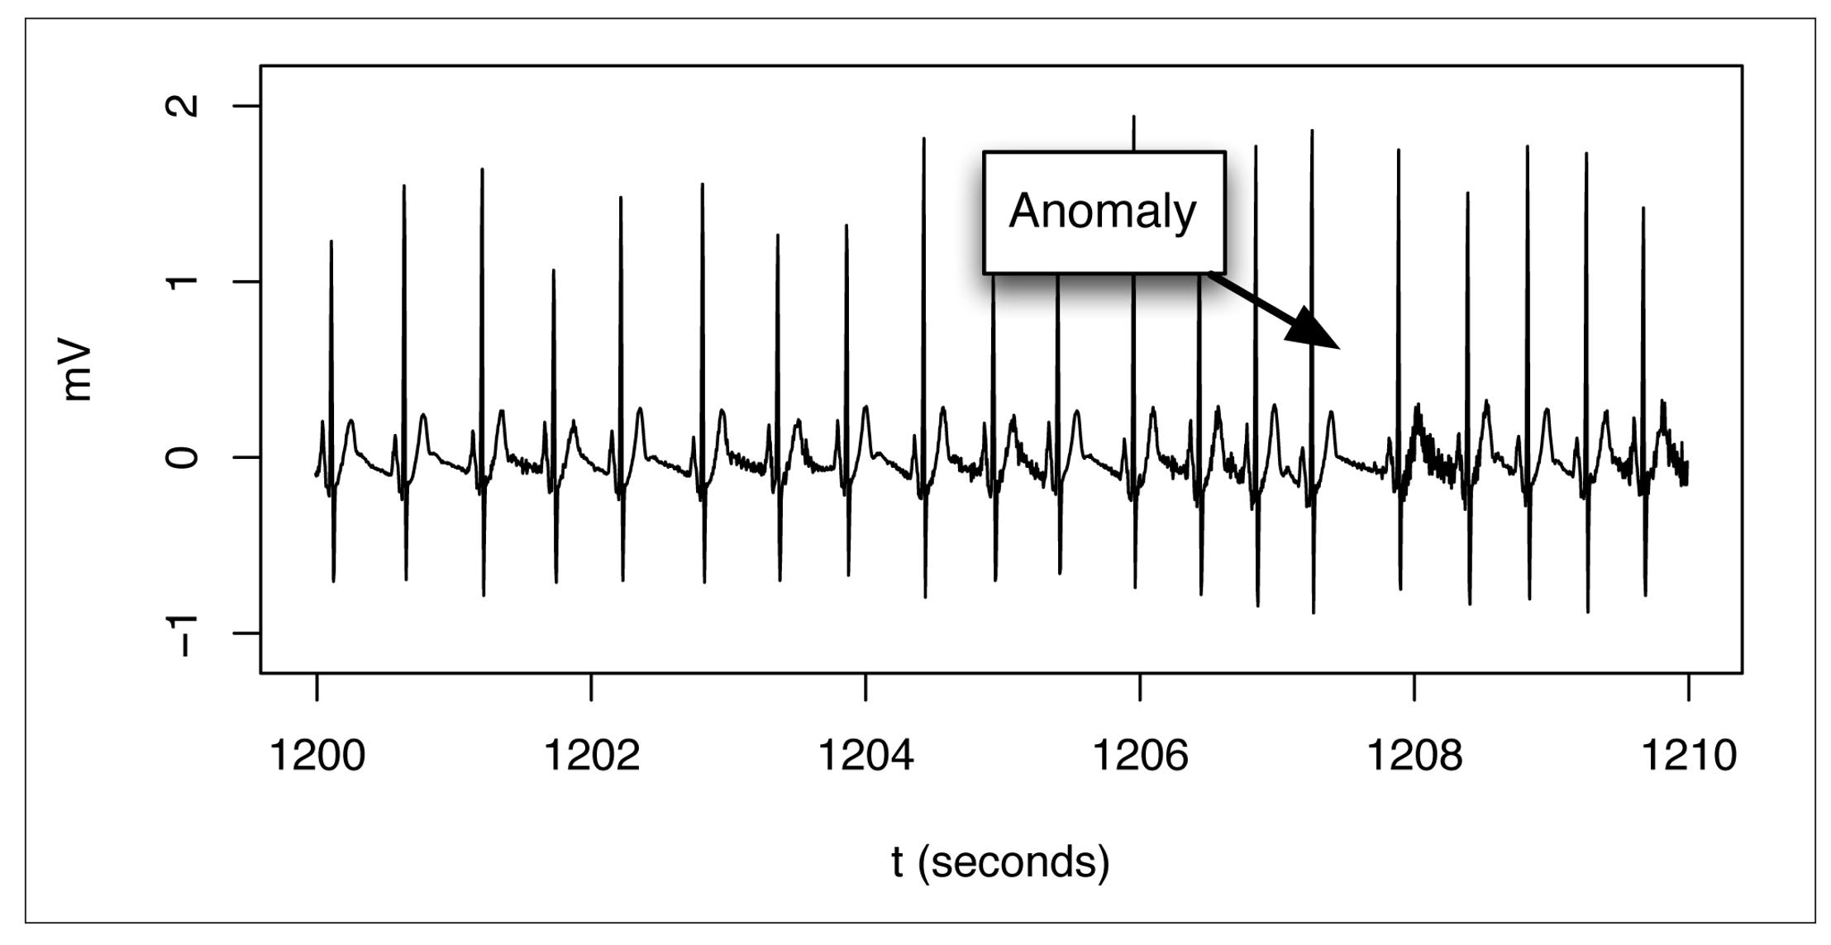
Finding Anomalies
Basis for anomaly detection is to establish what is normal and then compare new events to that pattern or model.
14
Notes:
For our EKG example, anomalous behavior is not the fact that there are spikes but the observation that their frequency fluctuates during an episode of abnormal heart behavior,
the basis for anomaly detection is to establish what is normal and then compare new events to that pattern or model.
This two-step process can be done in a variety of ways from very simple models of fairly straightforward systems that use an assigned threshold to send alerts for potential anomalies
sophisticated models that are adaptive and can deal with complex or shifting situations
In all of these cases, you are comparing observed behavior to what has been defined as normal.

Slide 16
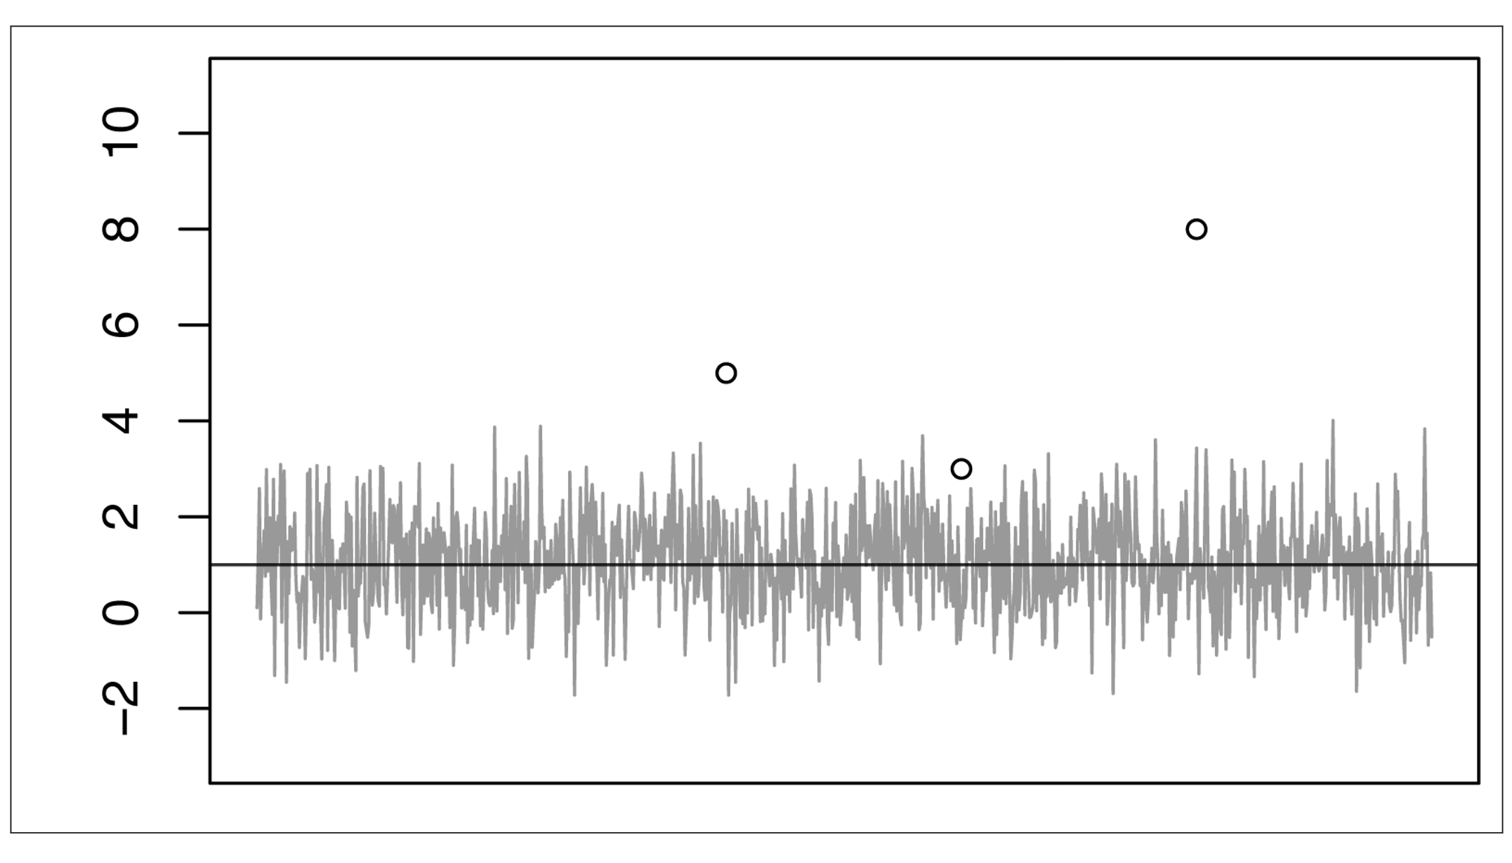
T-digest for Automatic Thresholding
whenever measurement exceeds a threshold that you have set, possibly for a certain amount of time, an alarm is sounded.
15
Notes:
The most common form of anomaly detector in use today is a manually-set threshold alarm to send an alert for possible anomalies.
Input to such an alarm is a numerical measurement of some kind.
The basic idea in this case is that whenever this measurement exceeds a threshold that you have set, possibly for a certain amount of time, an alarm is sounded.
This simple approach can work fairly well if the system being observed has a simple pattern of well-understood measurements
But this approach can become quite difficult to carry out effectively if you have a large number of measurements with behaviours that you do not understand very well.
A good first step in improving these systems is to change the way that the threshold is set.
Let’s think about the goal for a threshold and how it can be optimized.
Any particular value for a threshold will detect some fraction of the anomalies that you are trying to find, and if you have chosen the threshold well, that fraction of anomalies hopefully will be large.
At the same time, this threshold most likely will sometimes trigger false alarms, in cases in which normal noise in the data is detected erroneously as being a true anomaly.
Once again, if the system is built well and an appropriate threshold was chosen, the number of false alarms will be small. This trade-off between catching anomalies but trying to avoid too many false positives is what you are trying to optimize as you set the threshold.
This decision is a trade-off between the two kinds of error: false positives and false negatives.

Slide 17
Philosophy behind setting the Threshold
Two Strategies for Anomaly Detection
Two Strategies for Anomaly Detection
Two Strategies for Anomaly Detection
Anomaly Driven
Budget Driven
16
Notes:
The question you face is, “How many false positives are acceptable and what is the cost of possibly missing some real anomalies?”
Roughly speaking, people fall into two broad groups in their goals for optimizing the threshold.
On one side are those for whom the major objective is to detect a very large fraction of anomalies because the penalty for missing any of them is great. An example might be a medical life-support device for which very sensitive detection of anomalies is important.

Slide 18
Extreme Quantiles
x
Input
Signal
x > h?
h
t-digest
99.97%~ile
17
Notes:
Using t-Digest for Accurate Calculation of Extreme Quantiles
One of the advantages of t-digest is accuracy, especially for extreme quantiles; another is making the problem less cumbersome.
An incoming signal can be analyzed using a t-digest to find the threshold corresponding to any quantile.
The threshold is selected in terms of which percentile of the distribution of the incoming signal is desired.
In this case, a threshold of 99.97% has been selected.

Slide 19
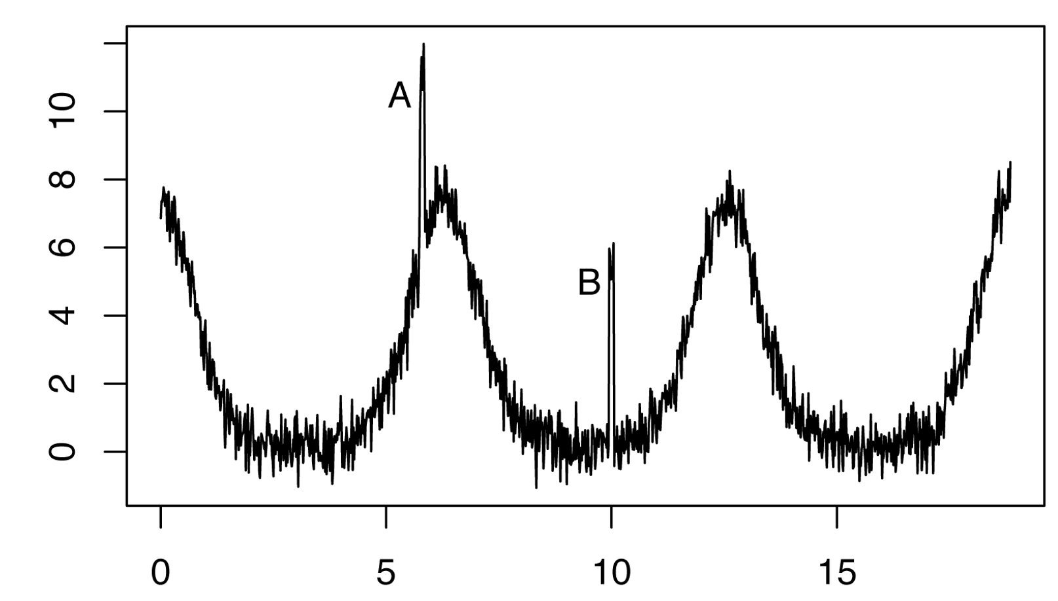
Issues with Simple Thresholds
With any kind of simple threshold detector, the anomaly at A in Figure will be detected easily, but the anomaly at B will not, even though they are both much larger than the noise level.
18
Notes:
The model for the threshold based anomaly detector is based on an assumption that the incoming signal has a nearly stationary and simple distribution so that a particular percentile will always be at a particular point.
If this assumption doesn’t hold, then the threshold as computed by the t-digest will result in the rate of true and false positives to vary as the distribution of the signal changes.
With any kind of simple threshold detector, the anomaly at A in Figure will be detected easily, but the anomaly at B will not, even though they are both much larger than the noise level.

Slide 20
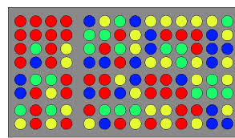
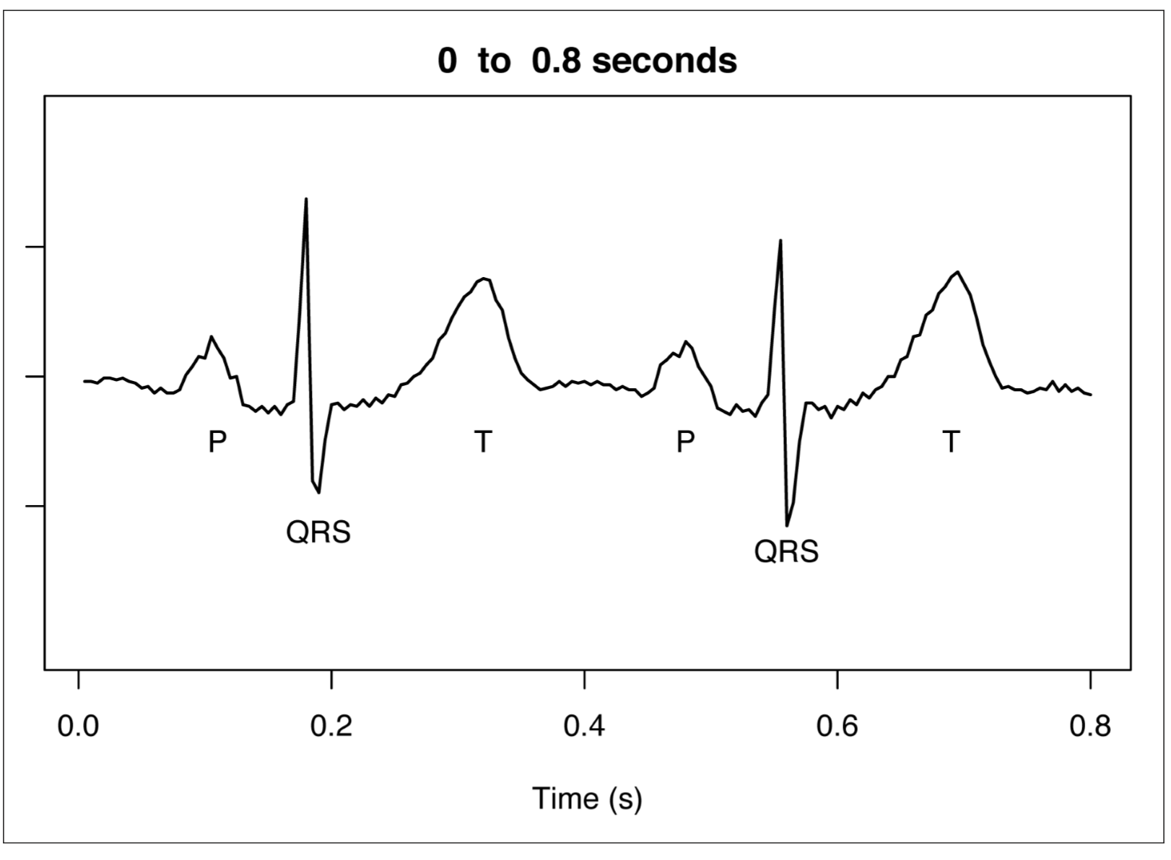
Windows and Clusters
An EKG signal is comprised of components that are complex but highly repetitive.
19
Notes:
Statistically speaking, what we are doing is describing our input as a time-varying base value combined with additive noise that has constant distribution and zero mean.
By building a model of exactly how we expect that base value to vary, we can build an anomaly detector that produces an alert whenever the input behaves sufficiently differently from what is expected.
We still have the challenge of finding an approachable, practical way to model normal for a very complicated curve such as the EKG.
Figure shows an expanded view of two heartbeats from an EKG signal.
Each heartbeat consists of several phases or pulses that correspond to electrical activity in the heart.
The first part of the heartbeat is the P wave, followed by the QRS complex, or group of pulses, and then the T wave.
The thing to notice is that each wave is strikingly similar from heartbeat to heartbeat. That heart is beating in a normal pattern.
To build a model that uses this similarity, we use a mathematical trick called windowing.
It’s a way of dealing with the regular but complex patterns when you need to build a model that can accurately predict them.
This method involves extracting short sequences of the original signal in such a way that that the short sequences can be added back together to re-create the original signal.

Slide 21
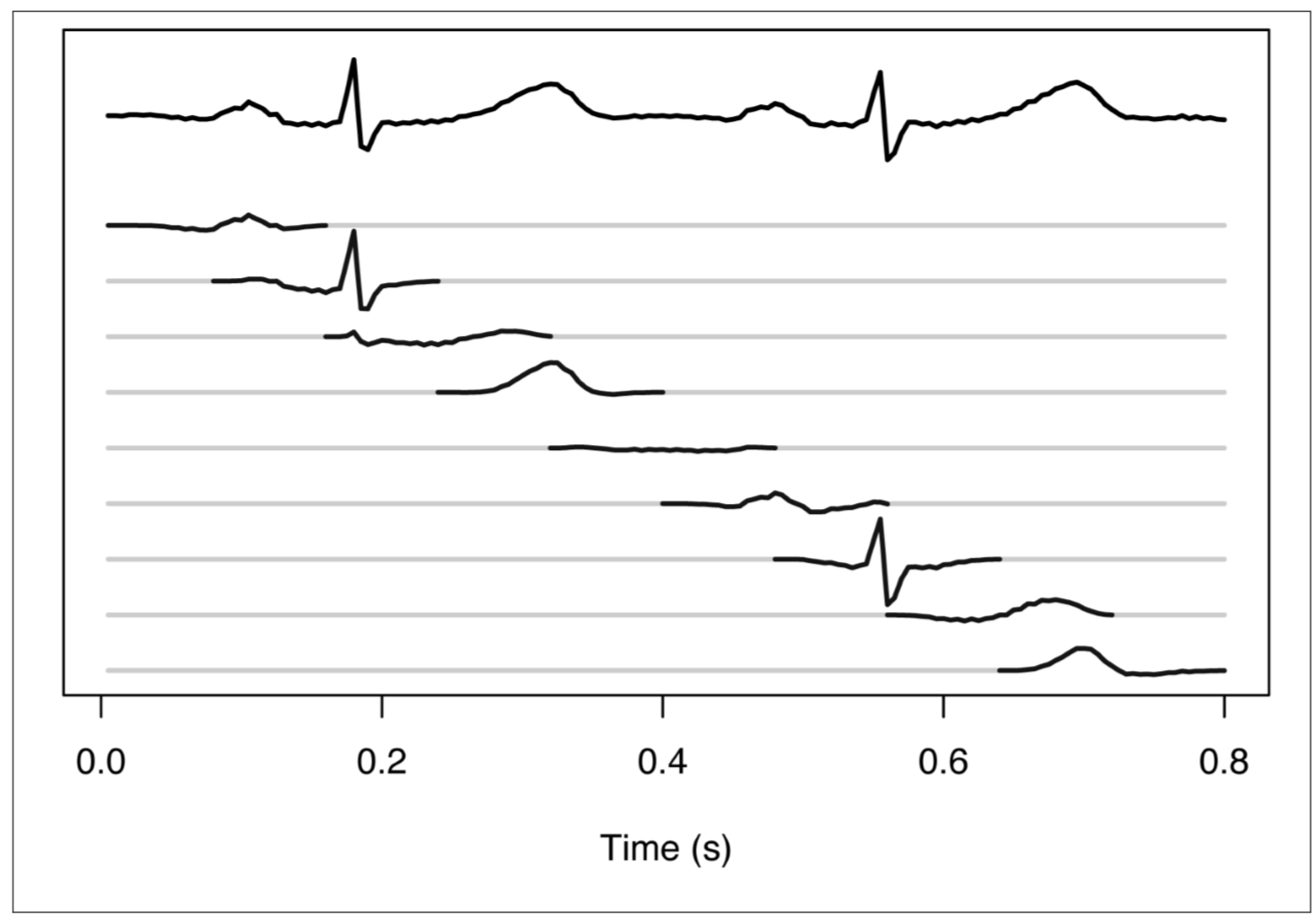
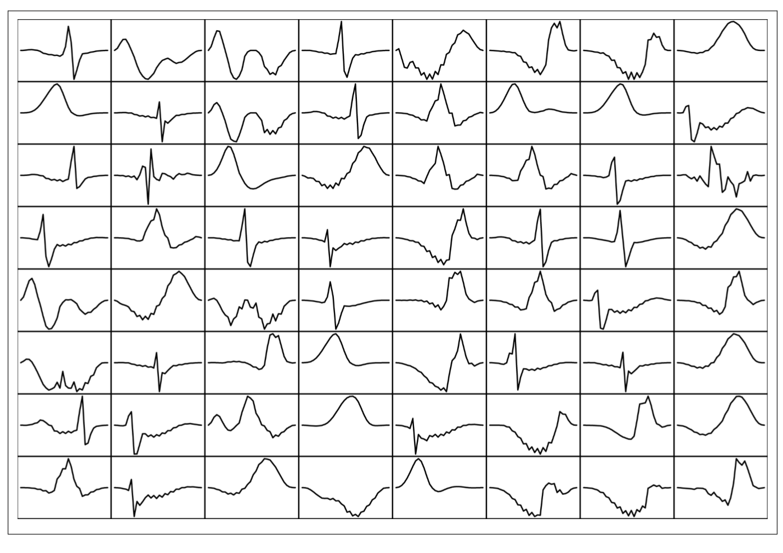
Windows and Clusters
20
Notes:
The first step of our analysis is to do windowing to break up the larger pattern into small components.
Figure shows how the EKG for these two heartbeats are broken up into a sequence of nine overlapping short signals.
As you can see, several of these signals are similar to each other.
This similarity can be exploited to build a heartbeat model by aligning and clustering all of the short signals observed in a long recording.
By looking at a long time series of data from an EKG, you can construct a dictionary of component shapes that are typical for normal heart behavior.
Figure 2 shows a selection of 64 out of 400 shapes from a dictionary constructed based on several hours of a real EKG recording.
These shapes clearly show some of the distinctive patterns found in EKG recordings.

Slide 22
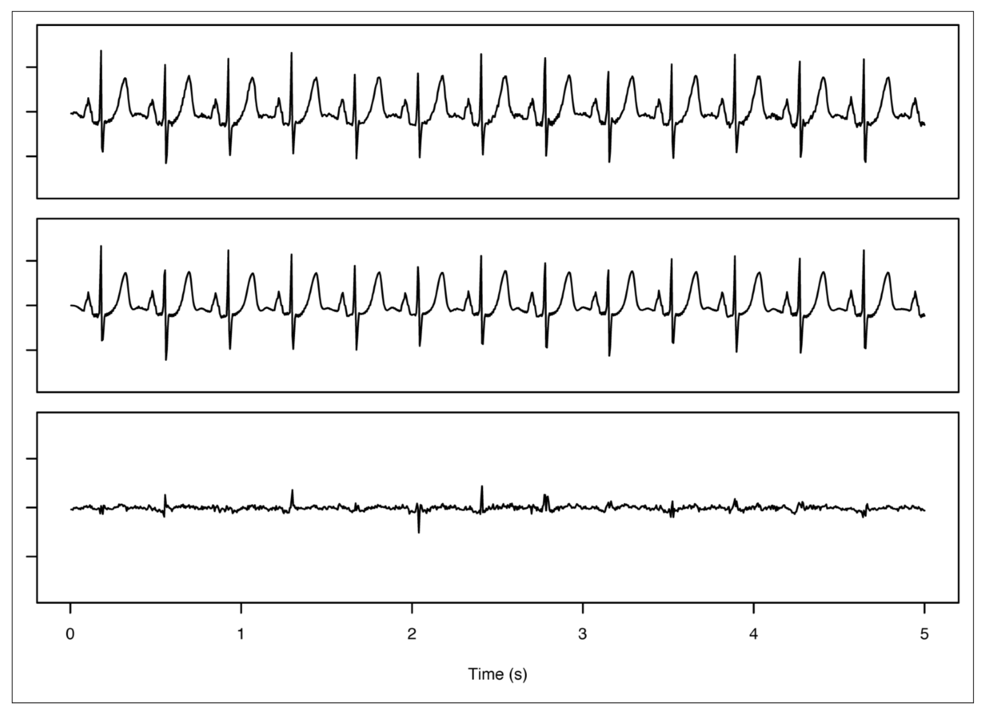
Behaviour on new data
21
Notes:
Now let’s see what happens when this technique is applied to a new EKG signal.
Remember, the goal here is to build a model of an observed signal, compare it to the ideal model, and note the level of error between the two.
Given that, a low level of errors in the comparison between the re-constructed signal and the ideal suggests that the observed signal is close to normal.
A mismatch indicates an abnormal signal, and thus an anomaly in heart function.
The top trace is the original signal,
the middle one is the reconstructed signal, and
the bottom trace shows the difference between the first two.
This last signal shows how well the reconstruction encodes the original signal and is called the reconstruction error.

Slide 23
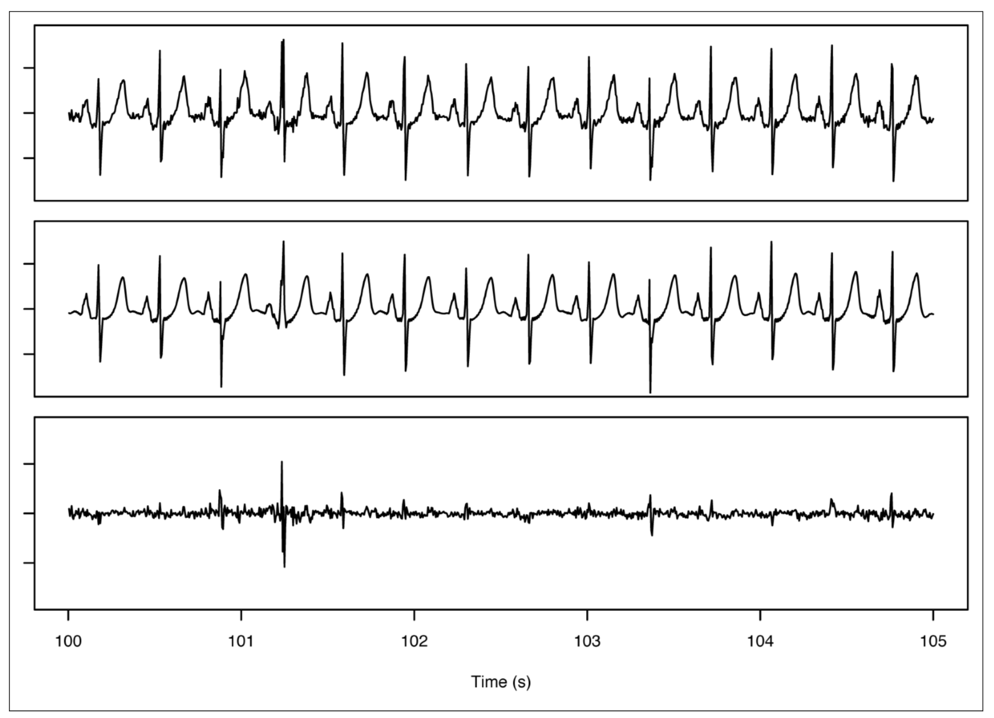
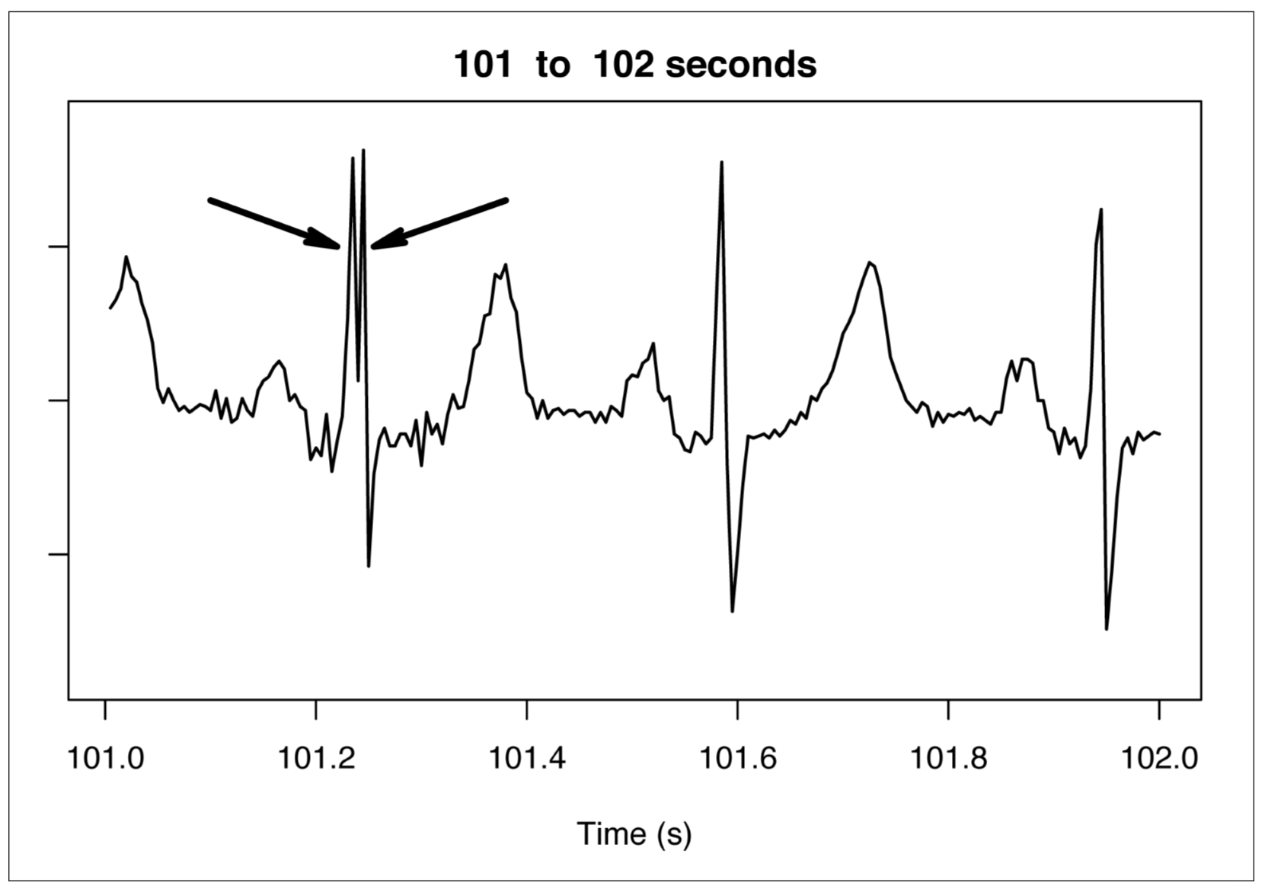
Behaviour on new data
22
Notes:
where you can see a spike in the reconstruction error just after 101 seconds. It is clear that the input signal (top trace) is not faithfully rendered by the reconstruction, but at this scale, it is hard to see exactly why.
If you expand the time scale, however, it is easy to see what is happening. Figure shows that at about 101.25 seconds, the QRS complex in the heartbeat is actually a double pulse. This double pulse is very different from anything that appears in a recording of a normal heartbeat, and that means that there isn’t a shape in the dictionary that can be used to reconstruct this signal.

Slide 24
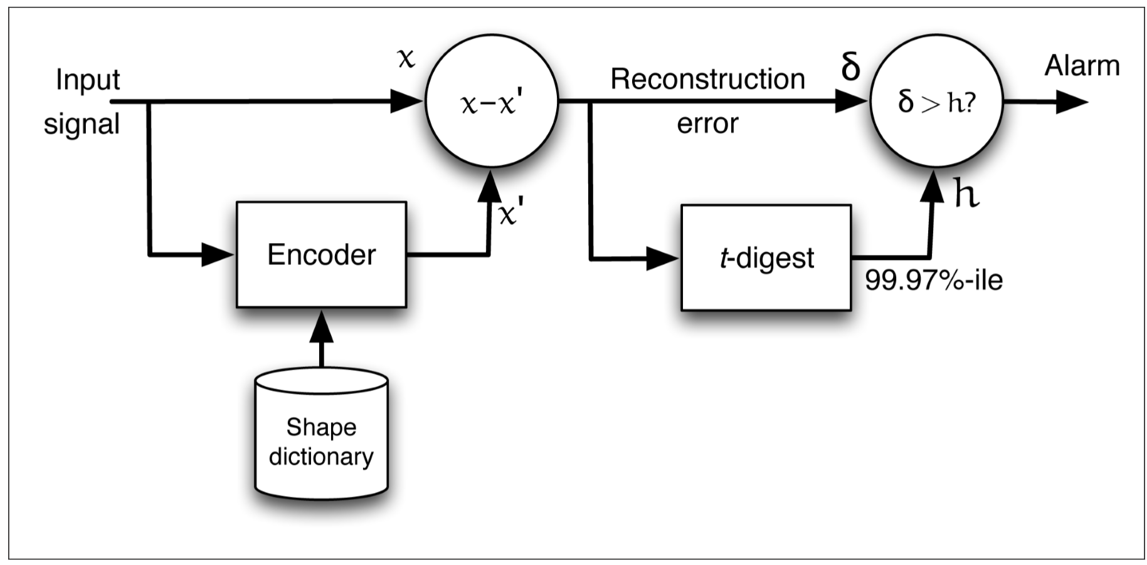
Flow
23
Notes:
Signal reconstruction error from an auto-encoder can be used to find anomalies in a complex signal.
Input signal x is analyzed using an encoder, which reconstructs x using a model in the form of a shape dictionary to produce a reconstructed signal x’.
The difference, x-x', is the reconstruction error δ.
Comparing δ to a threshold h gives us an alarm signal when the encoder cannot reconstruct x accurately as indicated by a large reconstruction error δ.

